Slide 1
Real Time Object Detection Overview: Advancements, Challenges, and Applications
Presented by:
Keyur Patel- 16010421073
HO DL-B1
IA-2

Slide 2
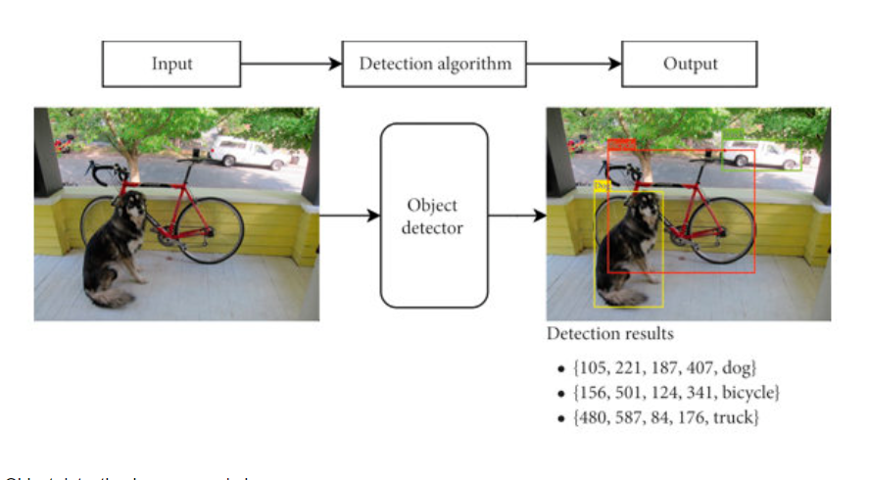
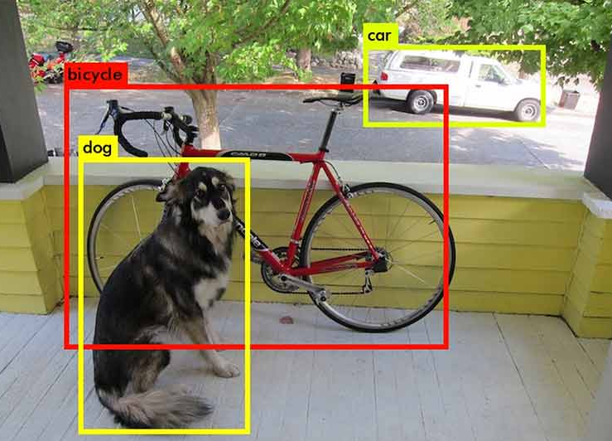
Introduction
Real-time object detection is a critical aspect of computer vision, enabling rapid and precise identification of objects within images and video streams.
Applications of real-time object detection span across various domains, including autonomous vehicles, robotics, surveillance, and augmented reality.
The emergence of deep learning, particularly Convolutional Neural Networks (CNNs), has revolutionized object detection by autonomously extracting intricate feature representations from visual data.

Slide 3
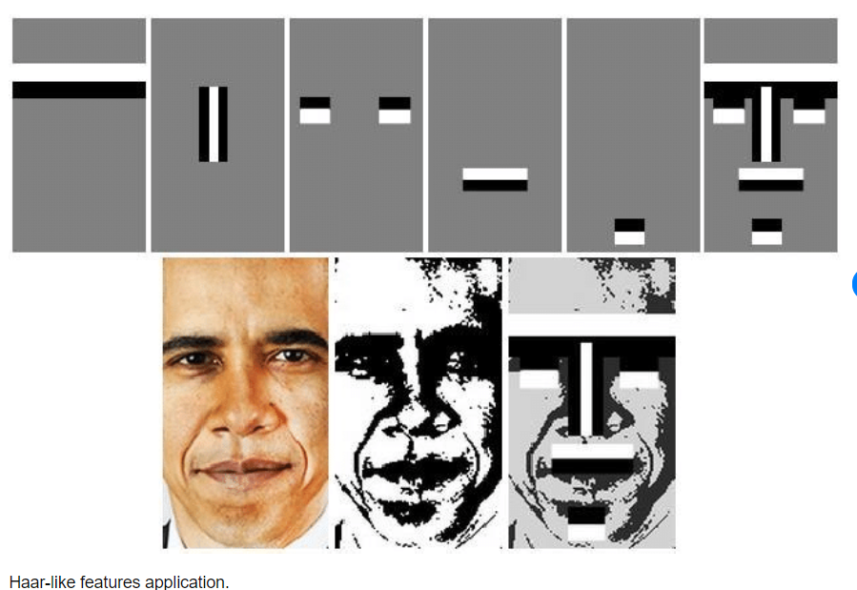
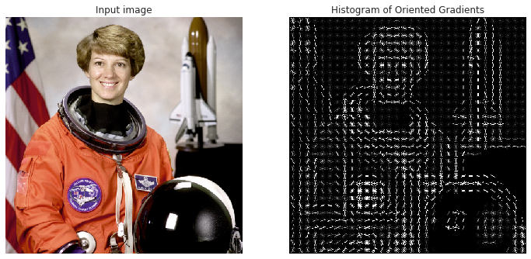
Traditional Approaches
The research paper discusses traditional approaches to object detection before the emergence of deep learning-based methods.
These traditional methods relied on handcrafted features and specialized algorithms.
Some of the notable traditional approaches include Histogram of Oriented Gradients (HOG), Haar-like Features, Feature Matching methods such as SIFT and SURF, Deformable Part Models (DPM), and Selective Search.
These methods were effective in certain scenarios but had limitations in computational efficiency.
Histogram of Oriented Gradients (HOG):
Haar like Features object detection

Slide 4
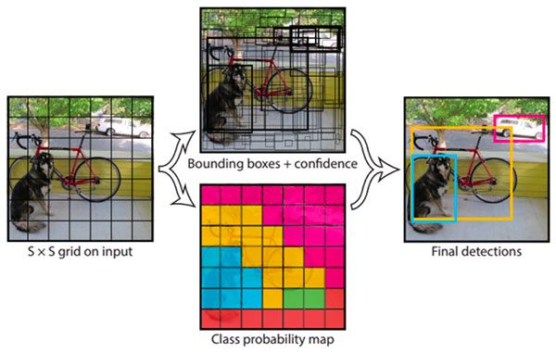
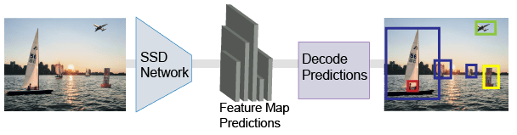
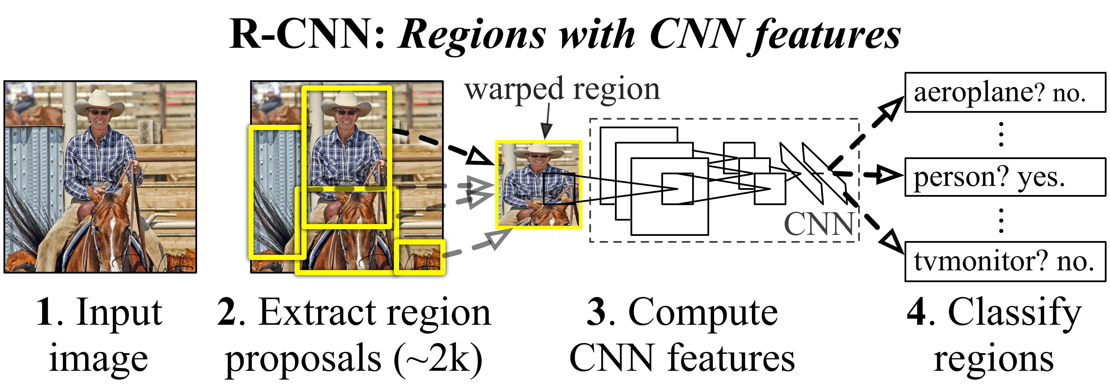
Deep Learning Architectures
The development of deep learning-based approaches, such as YOLO and SSD, has significantly improved the speed and accuracy of object detection by introducing end-to-end learning and novel architectures.
YOLO is a one-stage architecture that predicts bounding boxes and class probabilities in a single pass, eliminating the need for region proposal networks.YOLO has undergone several iterations, including YOLOv3 and YOLOv4, each introducing improvements in speed and accuracy.
SSD, on the other hand, is a fast model that predicts multiple bounding boxes and class scores per feature map location. It is renowned for its real-time efficiency and moderate to high accuracy. SSD achieves this through the use of multi-scale feature maps and anchor boxes, allowing it to efficiently detect objects in various scales and aspect ratios.
Faster R-CNN is a two-stage architecture that employs a Region Proposal Network (RPN) for object proposals. While it has a moderate processing speed, it excels in accuracy, making it suitable for applications where precision is paramount.

Slide 5
Dataset Used
The Research paper provides insights into the datasets used in deep learning models for real-time object detection. Notable datasets include:
COCO (Common Objects in Context) Dataset: This dataset offers detailed annotations for object detection and instance segmentation, fostering algorithm refinement and research.
Pascal VOC (Visual Object Classes) Dataset: The PASCAL VOC dataset supports rigorous object detection evaluation, providing a benchmark for assessing the performance of object detection algorithms.
KITTI Dataset: The KITTI dataset offers real-world data specifically tailored for autonomous driving applications.
Challenges Faced
Class imbalance
Varying object scales and viewpoints
Limited diversity
Privacy and ethical concerns

Slide 6
Optimization and regularization Techniques
Optimization and regularization techniques play a crucial role in enabling efficient and accurate real-time object detection, especially on resource-constrained devices.
Optimization Techniques:
Stochastic Gradient Descent (SGD): This is the most widely used optimization algorithm for training deep neural networks. It updates the model parameters in the direction of the negative gradient of the loss function.
Momentum: This technique helps accelerate SGD in the relevant direction and dampens oscillations. It adds a fraction of the previous update vector to the current update vector.
Regularization Techniques:
Data Augmentation: The paper highlights the importance of data augmentation as a regularization technique for training robust object detection models. This helps improve the model's generalization ability and prevents overfitting.
Model Quantization : The paper discusses model quantization as a technique to optimize models for deployment on resource-constrained devices. Quantization reduces the precision of model weights, effectively acting as a form of regularization by introducing weight sharing and sparsity.

Slide 7
Output Parameters
Bounding Box Coordinates:
Deep learning models for object detection output the coordinates of predicted bounding boxes around the detected objects. This is a fundamental output parameter required for localizing objects in the image.
Class Probabilities/Scores :
Along with bounding box coordinates, the models also output class probabilities or scores, indicating the likelihood of an object belonging to a particular class or category.
Precision and Recall:
The paper mentions precision and recall as evaluation metrics for assessing the accuracy of object detection models. Precision measures the accuracy of positive predictions, while recall measures the ability to identify all positive instances.

Slide 8
Applications and Future Directions
Autonomous Vehicles: Real-time object detection is crucial for autonomous driving systems, enabling vehicles to perceive and respond to pedestrians, vehicles, and obstacles for safe navigation and collision avoidance.
Surveillance and Security: Real-time object detection finds application in surveillance systems for identifying threats, intruders, or suspicious activities, enabling immediate response to security breaches.
Robotics: Robots equipped with real-time object detection capabilities can navigate environments, manipulate objects, and engage with their surroundings more effectively, enhancing human-robot collaborations.
Future Direction includes:
Real-time 3D Object Detection: The paper mentions the integration of real-time 3D object detection as a future direction, which could further enhance understanding and interaction between machines and the physical world.
Adaptive Learning: The paper mentions adaptive learning as a future direction, which could enable real-time object detection systems to continuously adapt and improve as they encounter new data and environments.

Slide 9
Conclusion
In conclusion, real-time object detection has emerged as a pivotal technology within the realm of computer vision and artificial intelligence. The convergence of deep learning algorithms, optimized architectures, and hardware acceleration has propelled remarkable advancements in this field, enabling machines to promptly perceive and comprehend their surroundings.
Questions Arised from Research paper
What are the key architectural innovations that have enabled deep learning models like YOLO and SSD to achieve real-time object detection performance while maintaining high accuracy?
How do different real-time object detection algorithms balance the trade-off between speed and accuracy,?
What are the primary challenges faced in deploying real-time object detection systems on resource-constrained devices?
How can real-time object detection systems be made more robust to challenging scenarios such as occlusion, clutter, and varying lighting conditions, while still maintaining real-time performance?

Slide 10
Thank You

